Slide 1

Calculating WAR, and looking at the issue with xAVG
By Jake Jensema

Slide 2

Why Is WAR Important?
WAR (Wins After Replacement) is a great stat to look at for players to see how much they truly contribute to their team. Looking at a player's WAR gives you a good all-around statistic to value a player because it factors in their offensive production as well as defensive. An important aspect of how WAR is calculated is we value all player's positions differently because a great shortstop is a lot more valuable than a great first baseman

Slide 3
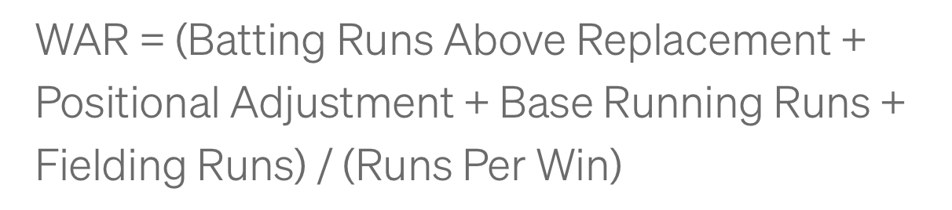
WAR Calculation
Using the following formula, we can calculate how many wins a player adds to their team over a replacement player. A replacement player in terms of the MLB is someone you could sign for league minimum or a minor league player. For college, we need to think about it regarding bench players, since college teams do not have a minor league. A bench player in less than 5 games is considered a replacement-level player.

Slide 4
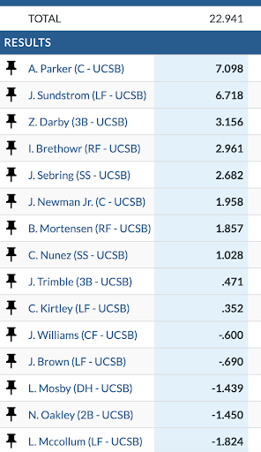
Results
Using Trumedia I did all of these calculations by hand. When looking at the league adjustment, instead of using all of Division 1 baseball, I specifically looked at The Big West Conference for the calculations. One thing to note is the scale of WAR is not the same as the MLB, in the MLB a position player receiving a WAR of 7 is practically guaranteed the MVP that year, but in this case, an MVP candidate sits more around the 9-10 range.
Note: Due to some limitations on Trumedia data, I was not able to calculate WAR for pitchers

Slide 5
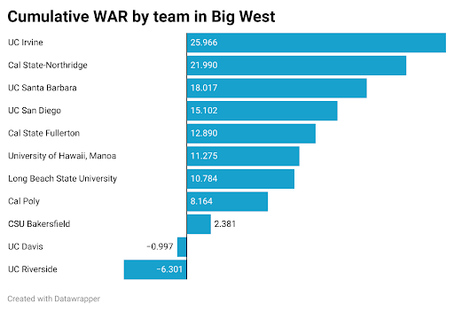
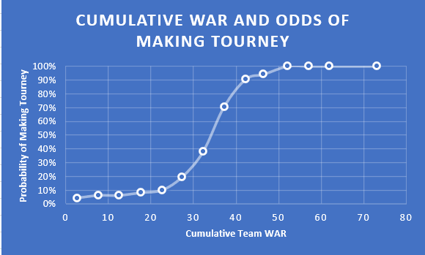
Cumulative team WAR
Looking at a team's cumulative WAR can give a better look at how good a team is. Another article I found gives this graphic to see how a team's cumulative war is related to the probability of making it to the CBBWS

Slide 6
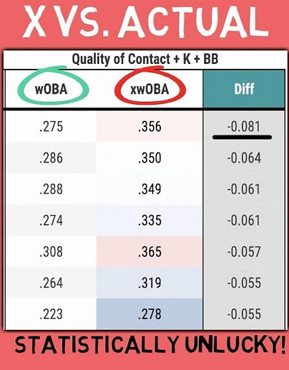
Looking at xAVG
xAVG is the expected average of a pitch that is hit. This is the probability that the ball that is put in play will result in a hit or not. xAVG is calculated using exit velocity and launch angle, so a ball that is put into play with an xAVG of .700 means that if that same ball was hit with the same launch angle and exit velocity, it would result in a hit 70% of the time. This gives a way to see how well a player is putting the ball into play without factoring in the defense because a player cannot control where the defense is playing. If a player is batting .247 over the past month but his xAVG is .303 you can see that the player is putting the ball in play well, but just hitting the ball right at the defense

Slide 7
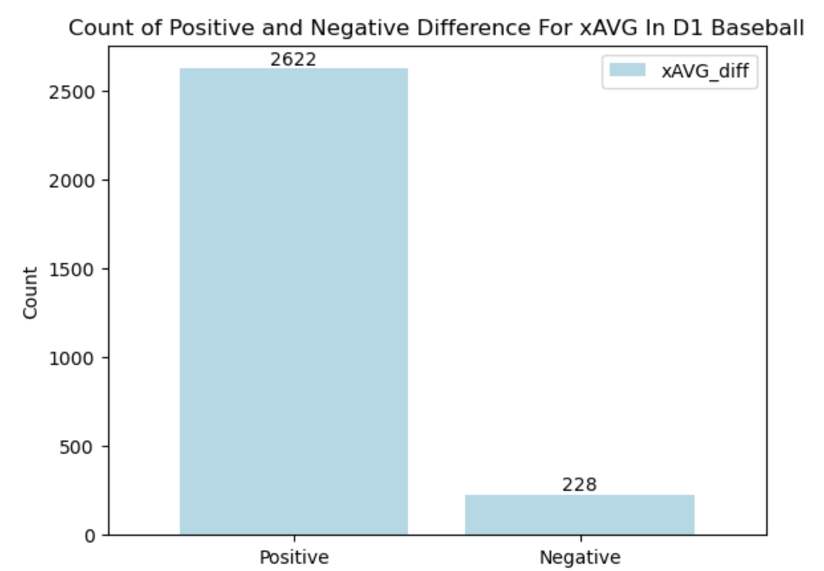
The Problem
When looking at Trumedia I noticed something a little off about the xAVG for players. It was always very low around the .200 and .250 values. This seemed off so I looked deeper into the data to see what was happening.
Looking at the player's actual AVG and their xAVG I saw that we see a huge favor of positive values which means that Trumedia’s xAVG stat was lower than the player's actual AVG. The vast difference in positive and negative values made me wonder how could 92% of players in D1 baseball be performing better than their xAVG.

Slide 8
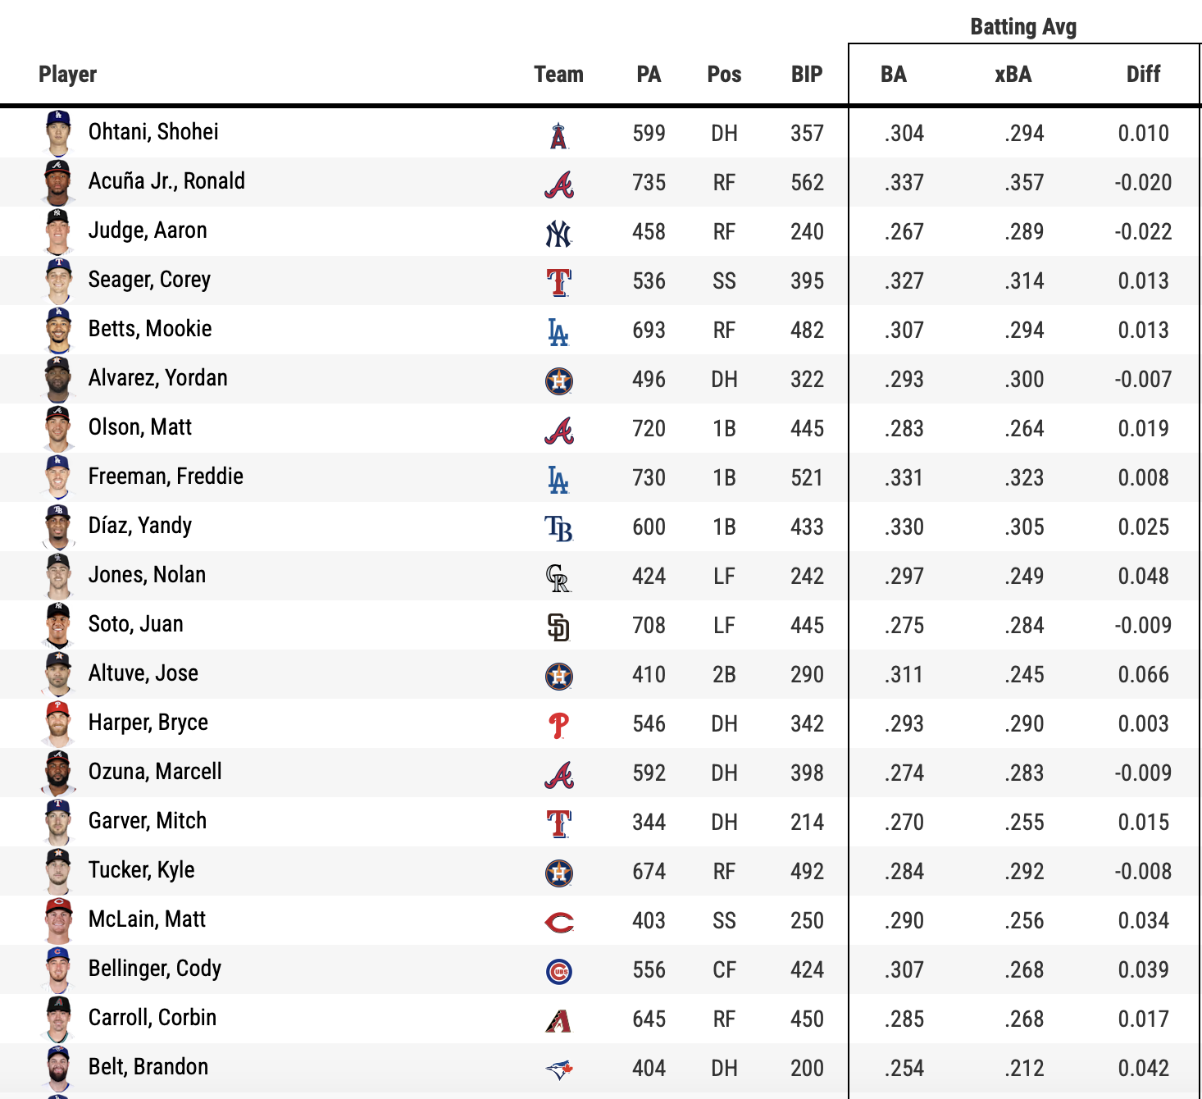
Comparing To MLB
For reference, this is looking at the difference between some of the top players in the MLB’s AVG and xAVG. We see that it’s more evenly distributed as to whether players are over or underperforming their xAVG

Slide 9
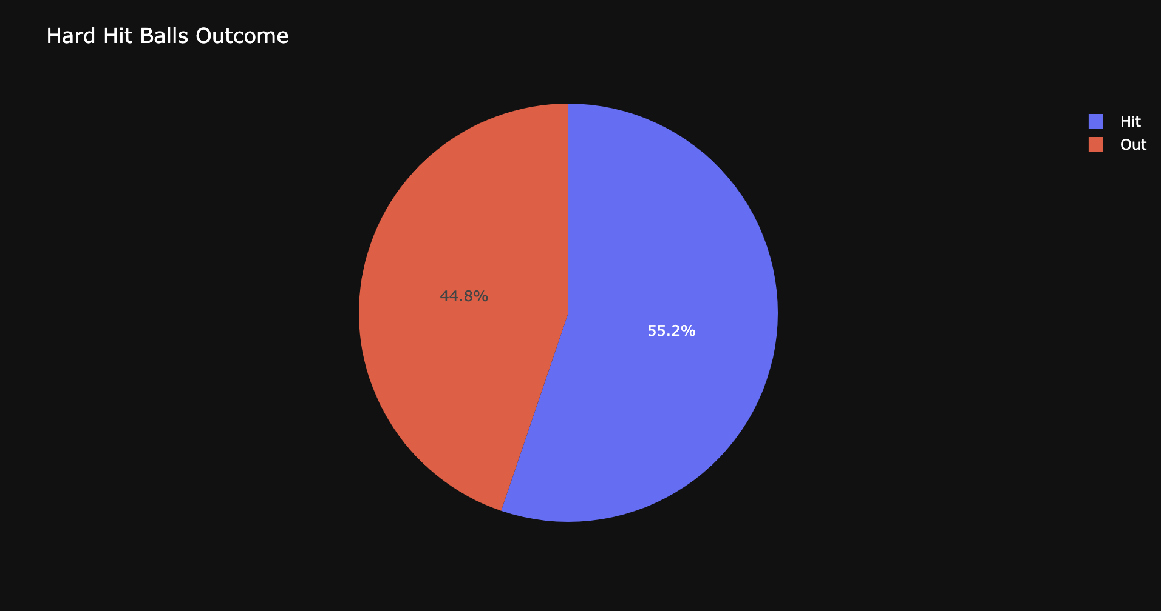
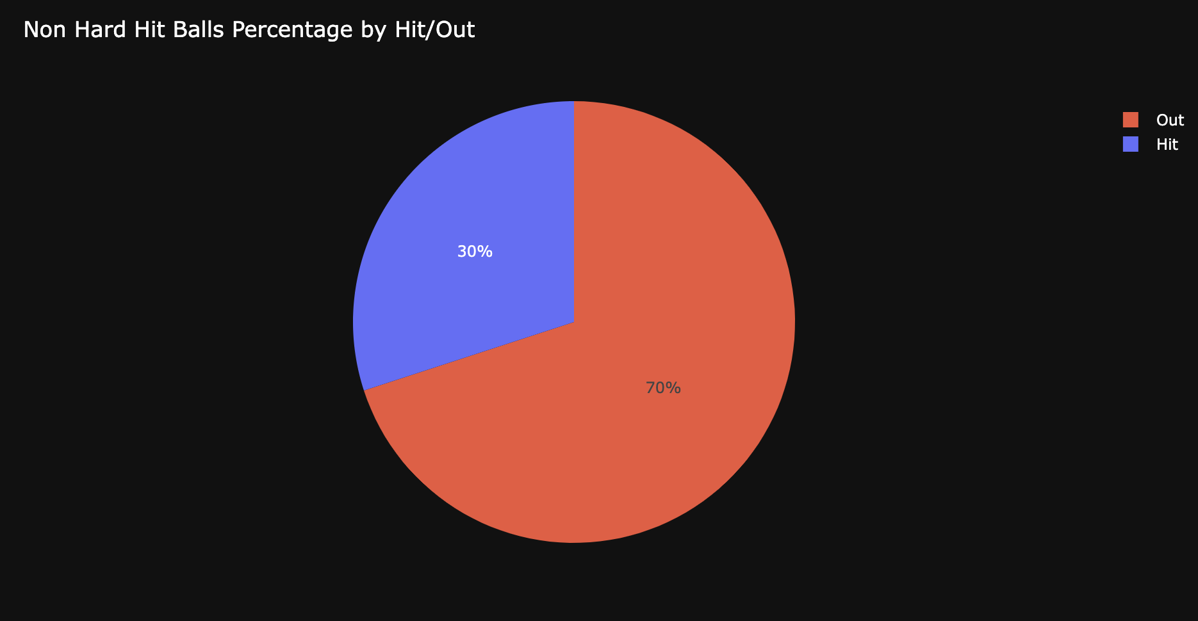
What's wrong with old method?
As we see below, looking at exit velocity, specifically hard-hit balls (exit velocity > 95mph) seems to work well at seeing if a ball will result in a hit or not

Slide 10
My Solution
The exact formula for xAVG on Trumedia is not available, but I do know for sure it is solely based on launch angle and exit velocity. My idea was that their calculation was too simple and needed a more sophisticated approach to get a better-expected value.
I took on a machine learning approach which involved using different types of statistical models to predict whether a ball will be classified as a hit or not, and from there looking at the probability that it will be predicted as a hit. This is because xAVG is calculated as the probability of a ball being a hit, so I needed to look at the probability of my model predicting a ball hit in play as a hit or not.
Instead of just using exit velocity and launch angle, I will also be looking at pCallStrike% and Good Pitch

Slide 11
pCallStrike%
pCallStrike% is a variable available on Trumedia which gives the % that the umpire would have called the pitch a strike if the batter did not swing. A low pCallStrike% means that the pitch was on the corner or barely off the plate. A high pCallStrike% means the pitch was distinctly in the middle of the strike zone. Using pCallStrike% allows us to factor the location of a pitch into the probability of the ball resulting in a hit. This is because simply a ball in the corner of the strike zone is harder to hit than a ball right down the middle meaning that the probability you get a hit on a ball put in play in the corner of the strike zone is lower than if the pitch was right down the middle.

Slide 12
Good Pitch
Good Pitch is a variable that I created that labels a pitch thrown as bad, good, or great. The way I decided what to label the pitch was through looking at the Induced Vertical Break, Vertical Break, Horizontal Break, Velocity, and Spin. First I calculated what the average value for all 5 of these metrics was for each type of pitch and from there I went ahead and labeled a pitch as great if all 5 metrics were > than the average, good if at least 3 were > average, and bad otherwise. This gives me a way to add a new encompassing variable that gives our model a way of factoring in that better pitches are harder to get hits on.

Slide 13
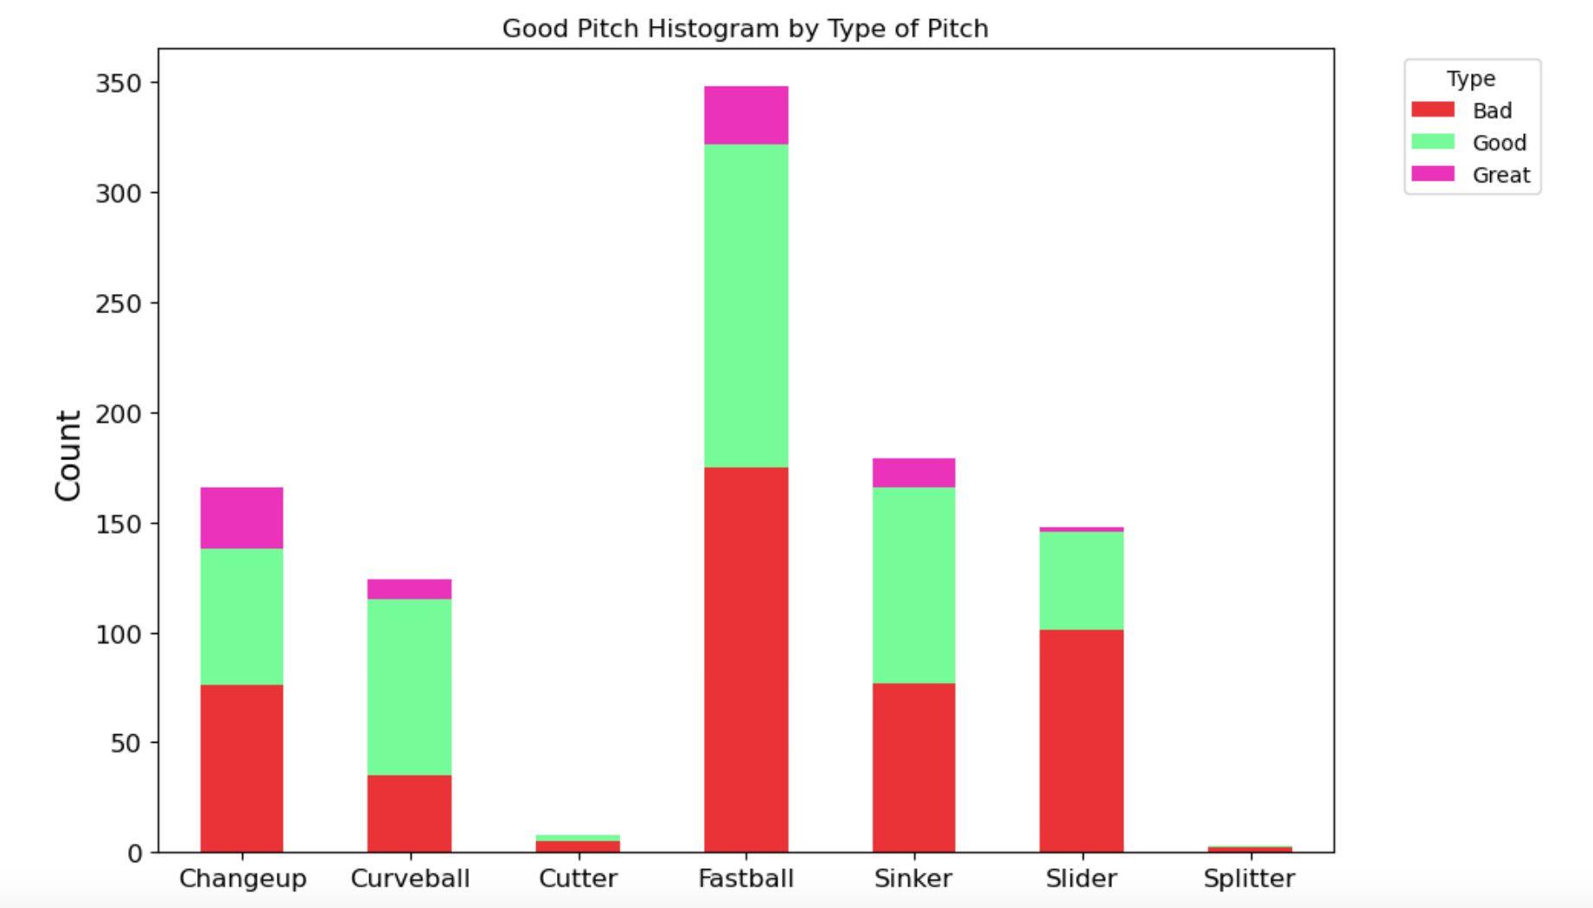
Good Pitch Visualized
Our Good Pitch distribution seems to look as we would expect

Slide 14
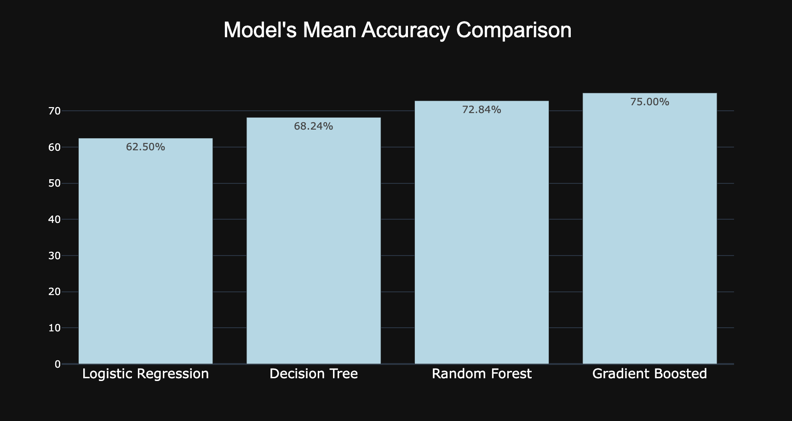
Results
We see that the 4 types of statistical models I used did pretty well in predicting whether a ball hit would be a hit or not. With our best model scoring 75%

Slide 15
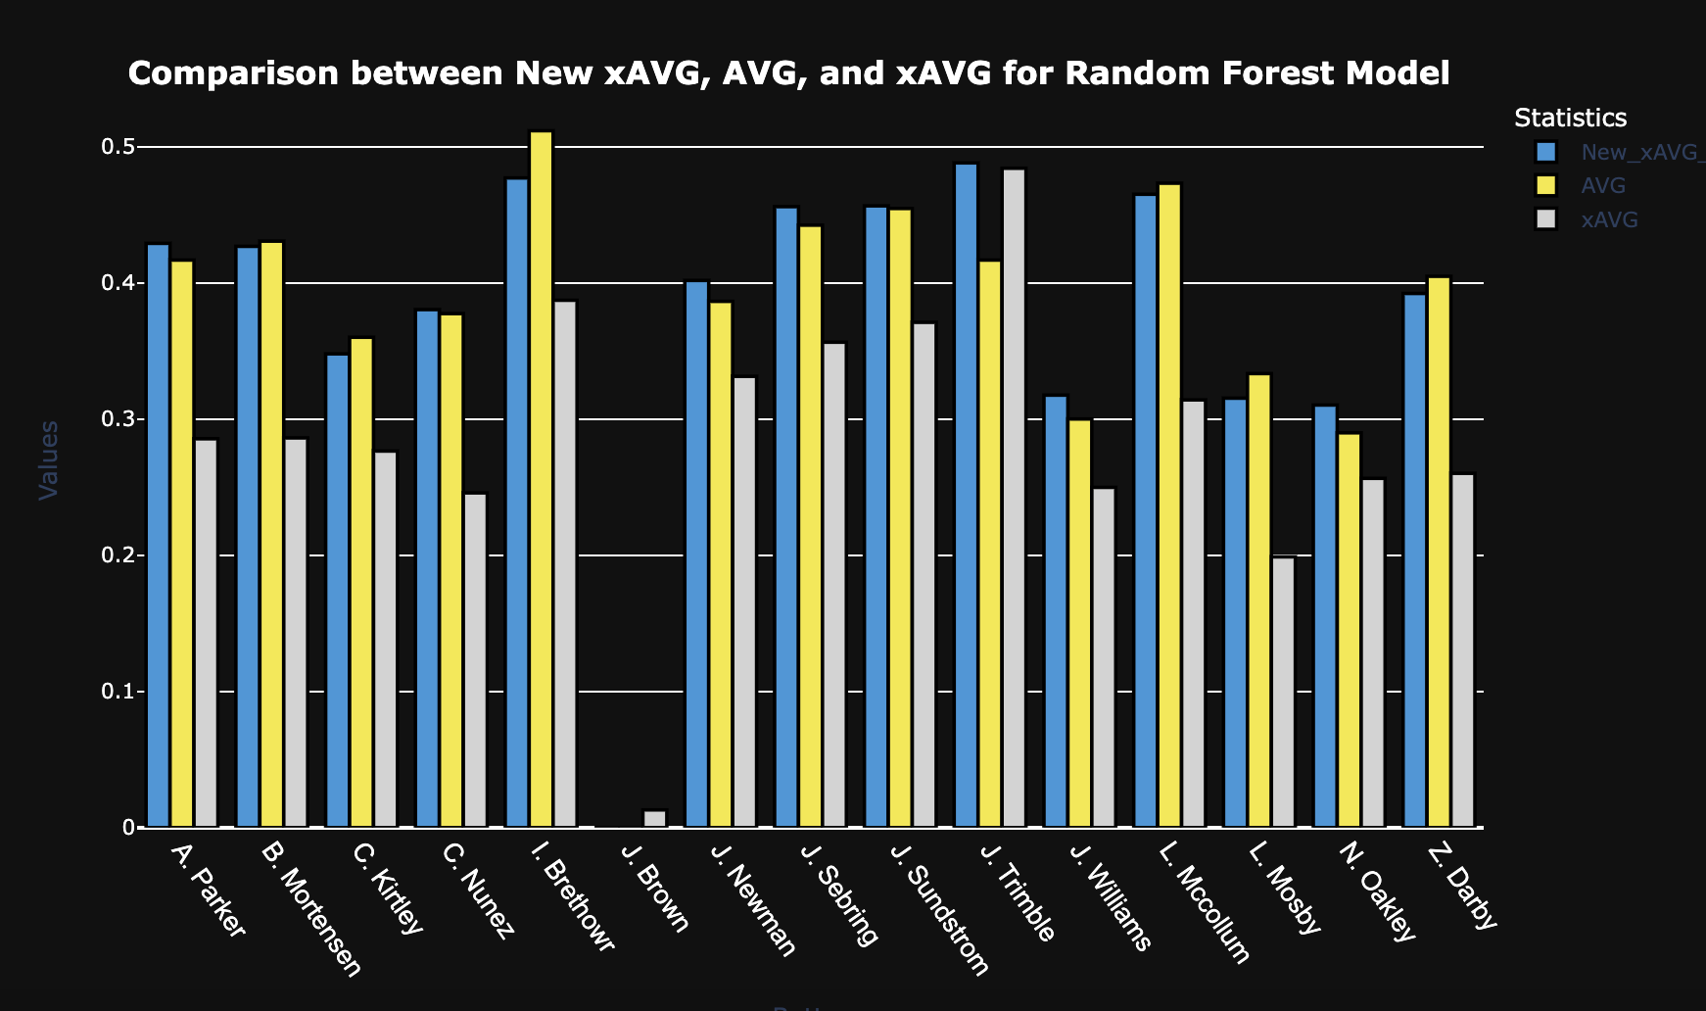
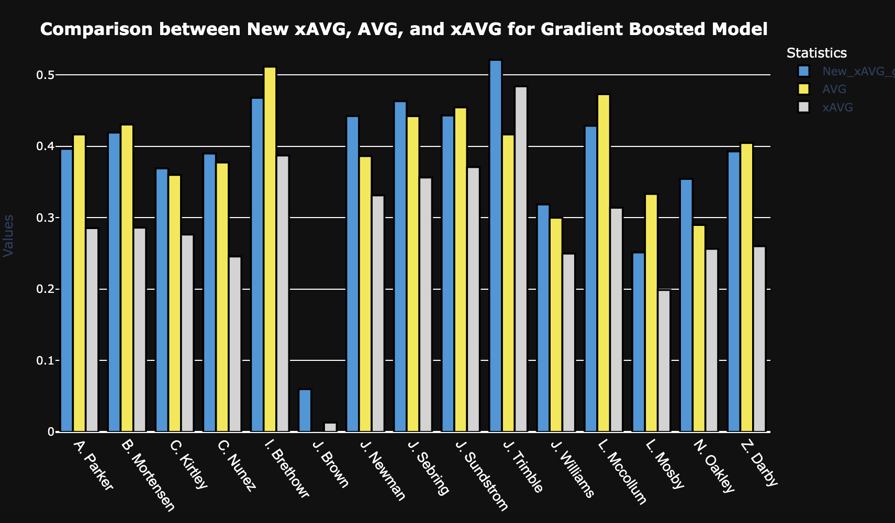
Comparing Our New xAVG With Old xAVG
The light blue value represents our New xAVG calculated in the sample data, the yellow is the player's actual AVG in our sample data, and the gray is the xAVG on Trumedia for the sample data. We see our models give a way better estimate on a player xAVG compared to the Trumedias calculation
Note: The reason the player's AVG is so high is because of the limited pitch-by-pitch data available on Trumedia.

Slide 16
Conclusion
With my new method of calculating xAVG I think that it can be useful to use for future data to give a more accurate method way of seeing how well a batter is putting the ball in play. As noted before, the pitch-by-pitch data which gives the values for xAVG along with exit velocity for each pitch was limited on Trumedia. Having more data would help the accuracy of my new method of calculating xAVG. Collecting these metrics like exit velocity and launch angle for all games would help for using my model in the future. I hope to go through and continue this project to help fix some other issues I have spotted, similarly xwOBA which is a great metric to look at for players' performance is just as skewed on Trumedia. Continuing this project to be able to get a more accurate xwOBA calculation for the team could help immensely.

Slide 17
Any Questions?
Feel free to reach out to me at
Jensema@UCSB.edu
408-427-2310
If you would like to ask any questions about my project as well as any ideas on what I can do to help with any ideas you have.
Thank You!

